Slide 1

A lecture of lectures about CoBIT and
ISO 27000
Dr. Hale
University of Nebraska at Omaha
Information Security and Policy– Lecture 6

Slide 2
Today’s topics: Last Time recap: FISMA related docs
IS27000 Series
slides from 2013 Jones and Bartlett Learning, LLC
slides from 2007 Luděk Novák, CISA, CISSP
ISO Assessment tool
CoBIT: Control Objectives for Information and related Technology
slides from 2007 IT Governance Institute
slides from 2013 Jones and Bartlett Learning, LLC

Slide 3
A Unified Framework For Information Security
The Generalized Model
Unique Information Security Requirements
The “Delta”
Intelligence Community
Department of Defense
Federal Civil Agencies
Foundational Set of Information Security Standards and Guidance
Standardized risk management process
Standardized security categorization (criticality/sensitivity)
Standardized security controls (safeguards/countermeasures)
Standardized security assessment procedures
Standardized security authorization process
Common Information Security Requirements
National security and non national security information systems

Slide 4
Risk Management Framework
Starting Point
FIPS 199 / SP 800-60
CATEGORIZE Information System
SP 800-37 / SP 800-53A
FIPS 200 / SP 800-53
Define criticality/sensitivity of information system according to potential worst-case, adverse impact to mission/business.
MONITOR
Security State
SELECT Security Controls
Continuously track changes to the information system that may affect security controls and reassess control effectiveness.
Select baseline security controls; apply tailoring guidance and supplement controls as needed based on risk assessment.
Security Life Cycle
SP 800-39
SP 800-37
SP 800-70
AUTHORIZE Information System
IMPLEMENT Security Controls
Determine risk to organizational operations and assets, individuals, other organizations, and the Nation;
if acceptable, authorize operation.
SP 800-53A
Implement security controls within enterprise architecture using sound systems engineering practices; apply security configuration settings.
ASSESS
Security Controls
Determine security control effectiveness
(i.e., controls implemented correctly, operating as intended, meeting security requirements for information system).

Slide 5
Security Categorization
Example: An Enterprise Information System
FIPS 199 | LOW | MODERATE | HIGH
Confidentiality | The loss of confidentiality could be expected to have a limited adverse effect on organizational operations, organizational assets, or individuals. | The loss of confidentiality could be expected to have a serious adverse effect on organizational operations, organizational assets, or individuals. | The loss of confidentiality could be expected to have a severe or catastrophic adverse effect on organizational operations, organizational assets, or individuals.
Integrity | The loss of integrity could be expected to have a limited adverse effect on organizational operations, organizational assets, or individuals. | The loss of integrity could be expected to have a serious adverse effect on organizational operations, organizational assets, or individuals. | The loss of integrity could be expected to have a severe or catastrophic adverse effect on organizational operations, organizational assets, or individuals.
Availability | The loss of availability could be expected to have a limited adverse effect on organizational operations, organizational assets, or individuals. | The loss of availability could be expected to have a serious adverse effect on organizational operations, organizational assets, or individuals. | The loss of availability could be expected to have a severe or catastrophic adverse effect on organizational operations, organizational assets, or individuals.
Mapping Information Types to FIPS 199 Security Categories
SP 800-60

Slide 6
Security Control Baselines
Master Security Control Catalog
Complete Set of Security Controls and Control Enhancements
Minimum Security Controls
Low Impact
Information Systems
Minimum Security Controls
Moderate Impact Information Systems
Minimum Security Controls
High Impact
Information Systems
Baseline #1
Baseline #2
Baseline #3
Selection of a subset of security controls from the master catalog—consisting of basic level controls
Builds on low baseline. Selection of a subset of controls from the master catalog—basic level controls, additional controls, and control enhancements
Builds on moderate baseline. Selection of a subset of controls from the master catalog—basic level controls, additional controls, and control enhancements

Slide 7
Tailoring Security Controls Scoping, Parameterization, and Compensating Controls
Minimum Security Controls
Low Impact
Information Systems
Minimum Security Controls
Moderate Impact Information Systems
Minimum Security Controls
High Impact
Information Systems
Low Baseline
Moderate Baseline
High Baseline
Tailored Security Controls
Tailored Security Controls
Tailored Security Controls
Enterprise #1
Operational Environment #1
Enterprise #2
Operational Environment #2
Enterprise #3
Operational Environment #3
Cost effective, risk-based approach to achieving adequate information security…

Slide 8
Large and Complex Systems
Authorization Boundary
Organizational Information System
Subsystem
Component
Subsystem
Component
Subsystem
Component
Local Area Network
Alpha
System Guard
Local Area Network
Bravo
System security plan reflects information system decomposition with adequate security controls
assigned to each subsystem component.
Security assessment procedures tailored for the security controls in each subsystem component
and for the combined system-level controls.
Security assessment performed on each subsystem component and on system-level controls not
covered by subsystem assessments.
Security authorization performed on the information system as a whole.

Slide 9
Applying the Risk Management Framework to Information Systems
Output from Automated Support Tools
Near Real Time Security Status Information
Authorization
Package
SECURITY PLAN
including updated Risk Assessment
SECURITY ASSESSMENT REPORT
PLAN OF ACTION AND MILESTONES
Artifacts and Evidence
INFORMATION SYSTEM
CATEGORIZE
Information System
MONITOR
Security State
SELECT
Security Controls
Risk Management
Framework
AUTHORIZE
Information System
IMPLEMENT
Security Controls
ASSESS
Security Controls

Slide 10
Extending the Risk Management Framework to Organizations
RISK EXECUTIVE FUNCTION
Enterprise-wide Oversight, Monitoring, and Risk Management
Security Requirements
Policy Guidance
SP
INFORMATION
SYSTEM
RMF
RISK MANAGEMENT FRAMEWORK
INFORMATION
SYSTEM
SP
Authorization Decision
SAR
SAR
Authorization Decision
POAM
POAM
SP
INFORMATION
SYSTEM
INFORMATION
SYSTEM
SP
Authorization Decision
SAR
SAR
Authorization Decision
POAM
POAM
SP
Common Security Controls
(Infrastructure-based, System-inherited)
SP
Authorization Decision
SAR
SAR
Authorization Decision
POAM
POAM

Slide 11
Trust Relationships
Organization One
INFORMATION SYSTEM
Organization Two
INFORMATION SYSTEM
Business / Mission
Information Flow
System Security Plan
System Security Plan
Security Assessment Report
Security Information
Security Assessment Report
Plan of Action and Milestones
Plan of Action and Milestones
Determining risk to the organization’s operations and assets, individuals, other organizations, and the Nation; and the acceptability of such risk.
Determining risk to the organization’s operations and assets, individuals, other organizations, and the Nation; and the acceptability of such risk.
The objective is to achieve visibility into and understanding of prospective partner’s information security programs…establishing a trust relationship based on the trustworthiness of their information systems.

Slide 12
Warning…
Policy Frameworks

Slide 13
Now entering the…
Policy Frameworks

Slide 14


of the
Policy Frameworks

Slide 15
(I’m sorry)
Policy Frameworks

Slide 16
ISO 27000 related slides
Policy Frameworks

Slide 17
ISO/IEC 27000
The International Organization for Standardization (ISO) and the International Electro-technical Commission (IEC) develop and publish international standards.
It is common to see these standards abbreviated to ISO/IEC.
ISO/IEC 27001 and 27002 are the most interesting of the family
Policy Frameworks

Slide 18
Overview of Documents
ISO 27000: Overview and Vocabulary
ISO 27001: ISMS Requirements
ISO 27002: Code of Practice
ISO 27003: ISMS Implementation Guidance
ISO 27004: ISM Measurement
ISO 27005: InfoSec Risk Management
ISO 27006: Requirements for Bodies Providing Audit and Certification of ISMS
ISO 27007 – 27008: Guidelines for Auditing InfoSec Controls
ISO 27014: Governance of InfoSec
ISO 27015: ISM Guidelines for Financial Services

Slide 19
Next Few slides from 2007 Luděk Novák, CISA, CISSP, modified by MLH 2015
Policy Frameworks

Slide 20
ISO/IEC 27000 family review
ISMS Overview and vocabulary
ISO/IEC 27000:2008 (ISO/IEC 13335-1)
ISMS Certification scheme ISO/IEC 27006:2007 (EA 7/03)
ISMS Requirements ISO/IEC 27001:2005
(BS 7799-2:2002)
Risk management BS 7799-3:2006
ISO/IEC 27005:2007
(ISO/IEC TR 13335-3:1998)
ISMS Measurement ISO/IEC 27004:2008
Annex A
ISMS Implementation guidelines ISO/IEC 27003:2008
ISMS Code of practice ISO/IEC 27002:2005
(ISO/IEC17799)
ISMS Auditor Guidelines
ISO/IEC 27007
Specific standards and guidelines
Policy Frameworks

Slide 21
ISO/IEC 27001:2013 principles
Definition of requirements on Information Security Management System (ISMS)
Information security management process based on PDCA Model
Plan – Do – Check – Act
Ensure the selection of adequate and proportionate security controls that protect information assets and give confidence to interested parties
All defined requirements are mandatory and it is not possible to exclude anyone
But it is not necessary to implement all security controls !!!
Policy Frameworks

Slide 22
ISMS Measurement as a feedback
Source: draft of ISO/IEC 27004
Policy Frameworks

Slide 23
Examples of ISMS metrics
Percentage (%) of system users/security personnel that have received basic awareness training
Average frequency of audit records review and analyses for inappropriate activity
Percentage of systems using automated mechanisms to conduct analysis and reporting of inappropriate activities
Percentage (%) of systems that are compliant with the baseline configuration
Percentage (%) of systems successfully addressed in the testing of the contingency plan
Percentage of accounts not associated with specific users
Percentage (%) of system components that undergo maintenance on schedule
Cost of information security incidents of unauthorized access to information systems, due to physical security failures
Percentage (%) of employees who signed acknowledgement that they have read and understood rules of behavior, before being authorized access to the information system
Source: NIST SP 800-80 Guide for Developing Performance Metrics for Information Security (draft)
http://csrc.nist.gov/publications/drafts/draft-sp800-80-ipd.pdf
Policy Frameworks

Slide 24
CMM® Security
ISO/IEC 21827 – Systems Security Engineering – Capability Maturity Model (SSE-CMM®)
Capability model for security
Advantage: more levels to compare security enforcement

Slide 25
[GOTO ISO 27001 control documents]
Policy Frameworks

Slide 26
Some slides from 2013 Jones and Bartlett, modified by MLH 2015-2017
Policy Frameworks

Slide 27
ISO/IEC 27002 (2015)
ISO/IEC 27002 has 19 sections of best practices, of those, there are 12 main areas that compose the framework
Policy Frameworks

Slide 28
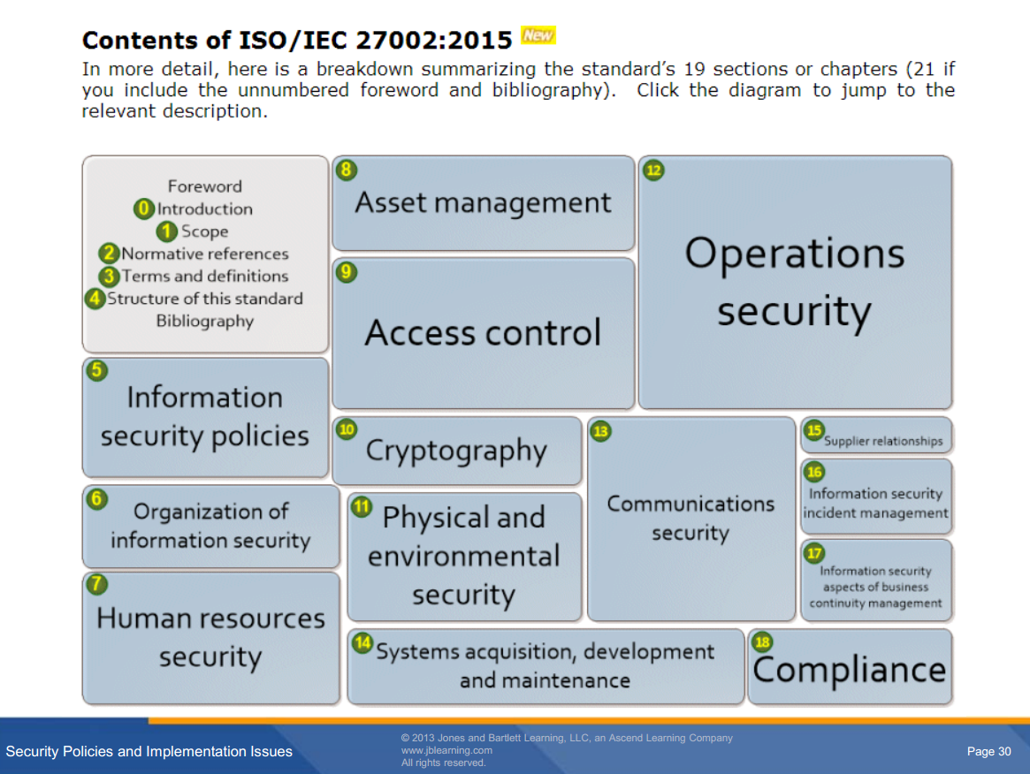


Slide 29
ISO/IEC 27002 (2015)
ISO/IEC 27002 outlines 12 main areas that compose the framework:
Risk assessment and treatment
Describes how to perform periodic risk assessments.
Security policy
Describes how management should define an information security policy.
Organizations usually maintain detailed security policies in a library. Information security standards, procedures, and guidelines support the library.
Policy Frameworks

Slide 30
ISO/IEC 27002 (2015)
ISO/IEC 27002 outlines 12 main areas that compose the framework:
Organization of information security
Describes how to design and implement an information security governance structure.
Covers the need for an internal group that manages the program.
Asset management
Describes inventory and classification of information assets. The organization should understand what information assets it holds, and manage its security appropriately.
Policy Frameworks

Slide 31
ISO/IEC 27002 (2015)
ISO/IEC 27002 outlines 12 main areas that compose the framework:
Human resources security
Describes security aspects for employees joining, moving, and leaving an organization. The organization should manage systems access rights.
Physical and environmental security
Describes the protection of computer facilities. Valuable IT equipment should be physically protected against malicious or accidental damage or loss.
Policy Frameworks

Slide 32
ISO/IEC 27002 (2015)
ISO/IEC 27002 outlines 12 main areas that compose the framework:
Communications and operations management
Describes management of technical security controls in systems and networks
Access control
Describes restriction of access rights of networks, systems, applications, functions, and data.
Addresses controlled logical access to IT systems, network, and data to prevent unauthorized.
Policy Frameworks

Slide 33
ISO/IEC 27002 (2015)
ISO/IEC 27002 outlines 12 main areas that compose the framework:
Information systems acquisition, development, and maintenance
Describes building security into applications in the Systems Development Life Cycle (SDLC)
Information security incident management
Describes anticipating and responding appropriately to information security breaches.
Information security events, incidents, and weaknesses should be promptly reported and properly managed.
Policy Frameworks

Slide 34
ISO/IEC 27002 (2015)
ISO/IEC 27002 outlines 12 main areas that compose the framework:
Business continuity management
Describes protecting, maintaining, and recovering business-critical processes and systems.
Covers contingency planning from analysis and documentation to regular testing of the plans.
Compliance
legal requirements
security policies and standards, and technical compliance
audit considerations.
Policy Frameworks

Slide 35
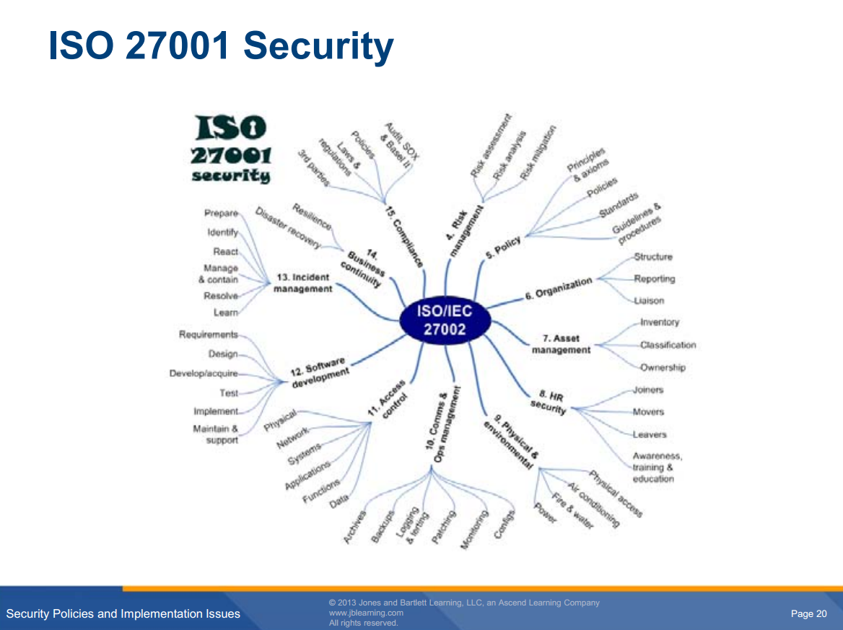

Slide 36
Next: CoBIT is at the highest level of “standards”
Policy Frameworks

Slide 37
(next slides from 2007 IT governance institute, modified by mlh 2015)
Policy Frameworks

Slide 38

Introductory COBIT Presentation
Overview of IT Governance and
the COBIT Framework

Slide 39
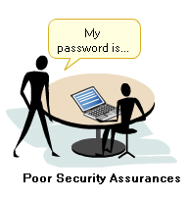
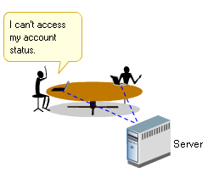
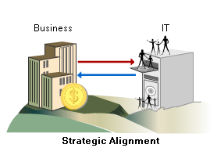
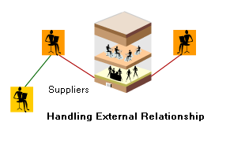
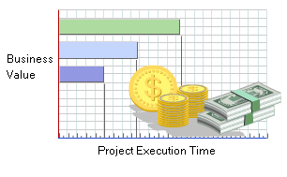
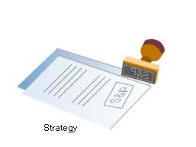
The Need for IT Governance
Security
Keeping
IT Running
Aligning
IT with
Business
Managing
Complexity
Value/Cost
Regulatory
Compliance
Organisations require a structured approach for managing these and other challenges.
This will ensure that there are agreed objectives for IT, good management controls in place and effective monitoring of performance to keep on track and avoid unexpected outcomes.
Notes:
Explain that there are many management challenges relating to the use of IT. The slide identifies some examples (the same as in the COBIT® Foundation Course). To manage this range of issues, a sound management approach is needed. The goals include agreed and aligned objectives for IT, effective controls, and effective tracking of performance. These are the main drivers for IT governance.

Slide 40

The Need for IT Governance
Enterprise governance is a set of
responsibilities and practices exercised by the
board and executive management with the goal
of:
Providing strategic direction
Ensuring that objectives are achieved
Ascertaining that risks are managed appropriately
Verifying that the enterprise’s resources are used responsibly
STRATEGIC
VALUE
ALIGNMENT
DELIVERY
PERFORMANCE
RISK
MEASUREMENT
www.itgi.org
MANAGEMENT
www.itgi.org
RESOURCE
MANAGEMENT
Notes:
This and the next slide provide definitions (as provided by ITGI) of ‘enterprise governance’ and ‘IT governance’. The diagram introduces the five focus areas of IT governance, which we will describe in more detail in a moment.
Emphasise the key aspects of enterprise governance and that they apply to IT and should include IT.

Slide 41
IT Governance, as Defined by ITGI
IT governance is:
The responsibility of the board of directors and executive management
An integral part of enterprise governance, consisting of the leadership, organisational structures and processes that ensure that the enterprise’s IT sustains and extends the organisation’s strategies and objectives
STRATEGIC
VALUE
ALIGNMENT
DELIVERY
PERFORMANCE
RISK
MEASUREMENT
www.itgi.org
MANAGEMENT
www.itgi.org
2005
64% Doing something about it
36%
RESOURCE
MANAGEMENT
2003
42% Not doing something about it
58%
Source: Surveys by PwC for the IT Governance Institute Sep-Oct 2003 and Sep-Oct 2005
Notes:
IT governance is really expressing enterprise governance in the context of IT, and it is a part of enterprise governance.
Emphasise that it needs the board and top management to be responsible for it to be effective.

Slide 42
Enterprise Governance Drives IT Governance
Enterprise governance is about:
Conformance
Adhering to legislation, internal policies, audit requirements, etc.
Performance
Improving profitability, efficiency, effectiveness, growth, etc.
Performance
Conformance
Enterprise governance and IT governance require a balance between conformance and performance goals directed by the board.
Notes:
Governance is about meeting strategic objectives (performance) while meeting legal and regulatory, contractual and other obligatory requirements often supported by policies (conformance). The goal is to achieve both in a balanced way.

Slide 43
IT Governance Focus Areas
Strategic
alignment
Focuses on ensuring the linkage of business and IT plans; on defining, maintaining and validating the IT value proposition; and on aligning IT operations with enterprise operations
Value delivery
Is about executing the value proposition throughout the delivery cycle, ensuring that IT delivers the promised benefits against the strategy, concentrating on optimising costs and proving the intrinsic value of IT
Resource
management
Is about the optimal investment in, and the proper management of, critical IT resources: applications, information, infrastructure and people. Key issues relate to the optimisation of knowledge and infrastructure.
Risk management
Requires risk awareness by senior corporate officers, a clear understanding of the enterprise’s appetite for risk, understanding of compliance requirements, transparency about the significant risks to the enterprise, and embedding of risk management responsibilities in the organisation
Performance
measurement
Tracks and monitors strategy implementation, project completion, resource usage, process performance and service delivery, using, for example, balanced scorecards that translate strategy into action to achieve goals measurable beyond conventional accounting
Notes:
This slide highlights the five focus areas of IT governance as defined by ITGI.

Slide 44
Making IT Governance Work
To make an IT governance implementation project successful:
Make IT governance a workable solution—able to deal with the challenges and pitfalls presented by IT.
Focus as much on improving performance and enabling competitive advantage as preventing problems.
Make IT governance a shared responsibility between the business (customer) and the IT service provider, with the full commitment and direction of the board.
Align IT governance within a wider enterprise governance scheme.
Boards and executive management need to extend enterprise governance to include IT, provide the necessary leadership and organisational structures, and insist on well-managed and properly controlled processes.
Notes:
The implementation of IT governance practices requires a practical and pragmatic approach. IT departments and service providers have a challenging function to provide services in complex environments and within demanding timescales. IT governance must help, not hinder, the services IT provides within these real-life constraints and be an enabler for better performance—not a blocker or administrative burden. Getting the business side and management involved is a critical success factor.

Slide 45
IT Governance Stakeholders
Board and
executive
Set direction for IT, monitor results and insist on corrective measures
Business management
Defines business requirements for IT and ensures that value is delivered and risks are managed
IT management
Delivers and improves IT services as required by the business
IT audit
Provides independent assurance to demonstrate that IT delivers what is needed
Risk and
compliance
Measures compliance with policies and focuses on alerts to new risks
Notes:
There are different groups of stakeholders who have (or should have) an interest in IT governance. These groups will be referred to throughout the course, with explanations of the roles they can play. Getting these groups involved at an early stage can make all the difference between a successful initiative and one that struggles to get significant attention.
Driving initiatives like this top-down vs. bottom-up is key—like the analogy of coming down a hill rather than climbing up against obstacles. However, in practice, it is not unusual for some IT functions to develop their IT governance ideas and techniques before exposing the concept to wider stakeholders.

Slide 46

COBIT Provides a Framework for IT Governance
COBIT helps bridge the gaps between business risks, control needs and technical issues. It provides good practices across a domain and process framework and presents activities in a manageable and logical structure.
COBIT:
Starts from business requirements
Is process-oriented, organising IT activities into a generally accepted process model
Identifies the major IT resources to be leveraged
Defines the management control objectives to be considered
Incorporates major international standards
Has become the de facto standard for overall control of IT
IT resources need to be managed by a set of naturally grouped processes. COBIT provides a framework that achieves this objective.
Notes:
This slide summarises the main attributes of the COBIT framework.

Slide 47
How Does COBIT Help Implement Effective IT Governance?
COBIT brings the following
advantages to an IT governance
implementation effort:
Enables mapping of IT goals to business goals and vice versa
Better alignment, based on a business focus
A view of what IT does that is understandable to management
Clear ownership and responsibilities based on process orientation
General acceptability with third parties and regulators
Shared understanding amongst all stakeholders, based on a common language
Fulfilment of the COSO (committee of sponsoring organizations) requirements for the IT control environment
Notes:
These are the main benefits gained by using COBIT to implement IT governance.
You could ask the class for their opinions and experiences.

Slide 48
COBIT and Other IT Management Frameworks
Organisations will consider and use a variety of IT models, standards and best practices. These must be understood in order to consider how they can be used together, with COBIT acting as the consolidator (‘umbrella’).
COSO
COBIT
ISO 17799/27000
ITIL
ISO 9000
WHAT
HOW
SCOPE OF COVERAGE
Notes:
It is normal for COBIT to be used in conjunction with other good practices, standards and in-house developed guidance. COBIT can act like an umbrella providing the framework for everything else.

Slide 49
Where Does COBIT Fit?
PERFORMANCE:
Business Goals
CONFORMANCE
Basel II, Sarbanes-
Oxley Act, etc.
Drivers
Enterprise Governance
Balanced
Scorecard
COSO
IT Governance
COBIT
Best Practice Standards
ISO
9001:2000
ISO
17799 / 27000
ISO
20000
Processes and Procedures
QA
Procedures
Security
Principles
ITIL
Notes:
This slide shows how COBIT fits into the hierarchy—from business drivers at the top, down to specific governance processes and procedures. COBIT is the bridge between business and enterprise governance requirements and specific IT governance practices.

Slide 50

COBIT Framework
The COBIT framework was created with the main characteristics:
Business-focused
Process-oriented
Controls-based
Measurement-driven
The acronym COBIT stands for Control Objectives for Information and related Technology.
COBIT Framework Characteristics

Slide 51
COBIT: An IT Control Framework
Governance
Management
Evolution
Control
Audit
COBIT 1
COBIT 2
COBIT 3
COBIT 4
1996
1998
2000
2005
For latest updates on COBIT, log on to www.isaca.org/cobit.

Slide 52

COBIT: Value and Limitations
COBIT:
Has internationally accepted good practices
Is management-oriented
Is supported by tools and training
Is freely downloadable
Allows the knowledge of expert volunteers to be shared and leveraged
Continually evolves
Is maintained by a reputable not-for-profit organisation
Maps 100 percent to COSO
Maps strongly to all major, related standards
Is a reference, not an ‘off-the-shelf’ cure
Enterprises still need to analyse control requirements and customise COBIT based on their:
Value drivers
Risk profile
IT infrastructure, organisation and project portfolio
LIES!!!

Slide 53
COBIT Components
An organisation depends on reliable and timely data and information. COBIT components provide a comprehensive framework for delivering value while managing risk and control over data and information.
IT Resources
Business Strategy
IT Processes
Information Criteria

Slide 54
COBIT: Advantages
Some of the advantages of adopting COBIT are:
COBIT is aligned with other standards and good practices and should be used together with them.
COBIT’s framework and supporting best practices provide a well-managed and flexible IT environment in an organisation.
COBIT provides a control environment that is responsive to business needs and serves management and audit functions in terms of their control responsibilities.
COBIT provides tools to help manage IT activities.

Slide 55

COBIT and IT Governance
COBIT focuses on improving IT governance in organisations.
COBIT provides a framework to manage and control IT activities and supports five requirements for a control framework.
Provides sharper business
Defines a common language
focus
Ensures process orientation
Control Framework
Helps meet regulatory requirements
Has general acceptability amongst organisations

Slide 56
COBIT and IT Governance (Cont.)
Business Focus
COBIT achieves sharper business focus by aligning IT with business objectives.
The measurement of IT performance should focus on IT’s contribution to enabling and extending the business strategy.
COBIT, supported by appropriate business-focused metrics, can ensure that the primary focus is value delivery and not technical excellence as an end in itself.
Provides sharper business
Defines a common language
focus
Ensures process orientation
Helps meet regulatory requirements
Control Framework
Has general acceptability amongst organisations

Slide 57
COBIT and IT Governance (Cont.)
Process Orientation
When organisations implement COBIT, their focus is more process-oriented.
Incidents and problems no longer divert attention from processes.
Exceptions can be clearly defined as part of standard processes.
With process ownership defined, assigned and accepted, the organisation is better able to maintain control through periods of rapid change or organisational crisis.
Provides sharper business
Defines a common language
focus
Ensures process orientation
Helps meet regulatory requirements
Control Framework
Has general acceptability amongst organisations

Slide 58
COBIT and IT Governance (Cont.)
General Acceptability
COBIT is a proven and globally accepted standard for increasing the contribution of IT to organisational success.
The framework continues to improve and develop to keep pace with good practices.
IT professionals from all over the world contribute their ideas and time to regular review meetings.
Provides sharper business
Defines a common language
focus
Ensures process orientation
Helps meet regulatory requirements
Control Framework
Has general acceptability amongst organisations

Slide 59
COBIT and IT Governance (Cont.)
Regulatory Requirements
Recent corporate scandals have increased regulatory pressures on boards of directors to report their status and ensure that internal controls are appropriate. This pressure covers IT controls as well.
Organisations constantly need to improve IT performance and demonstrate adequate controls over their IT activities.
Many IT managers, advisors and auditors are turning to COBIT as the de facto response to regulatory IT requirements.
Provides sharper business
Defines a common language
focus
Ensures process orientation
Helps meet regulatory requirements
Control Framework
Has general acceptability amongst organisations
Security Baseline comes in here

Slide 60
COBIT and IT Governance (Cont.)
Common Language
A framework helps get everybody on the same page by defining critical terms and providing a glossary.
Co-ordination within and across project teams and organisations can play a key role in the success of any project.
Common language helps build confidence and trust.
Provides sharper business
Defines a common language
focus
Ensures process orientation
Helps meet regulatory requirements
Control Framework
Has general acceptability amongst organisations

Slide 61
COBIT: Premise
The COBIT framework is based on the premise that IT needs to deliver the information that an enterprise requires to achieve its objectives.
for achieving
Business Objectives
i
Business Processes
to
Information
provide
IT Resources and Processes
The COBIT framework helps align IT with the business by focusing on business information requirements and organising IT resources. COBIT provides the framework and guidance to implement IT governance.

Slide 62
COBIT: Principle
The principle of the COBIT framework is to link management’s IT expectations with management’s IT responsibilities. The objective is to facilitate IT governance to deliver IT value whilst managing IT risks.
IT Resources
Business Strategy
IT Processes
Information Criteria

Slide 63

COBIT Framework
As a control and governance framework for IT, COBIT focuses on two key areas:
Providing the information required to support business objectives and requirements
Treating information as the result of the combined application of IT-related resources that need to be managed by IT processes
Information Criteria
Effectiveness
Efficiency
Confidentiality
Integrity
Availability
Compliance
Reliability
IT Process
Business Requirement
Control Approach
IT Resources
IT Processes
Applications
Consideration
……………………………
……………………………
……………………..……..
Domains
Information
Processes
Activities
Infrastructure
People

Slide 64

COBIT Cube
The COBIT framework describes how IT processes deliver the information that the business needs to achieve its objectives.
For controlling this delivery, COBIT provides three key components, each forming a dimension of the COBIT cube.
Business Requirements for Information Criteria
IT Resources
IT Processes

Slide 65

COBIT Cube: IT Processes
COBIT describes the IT life cycle with the help of four domains:
Plan and Organise
Acquire and Implement
Deliver and Support
Monitor and Evaluate
Processes are series of activities with natural control breaks. There are 34 processes across the four domains. These processes specify what the business needs to achieve its objectives. The delivery of information is controlled through 34 IT processes.
Activities are actions that are required to achieve measurable results. Moreover, activities have life cycles and include many discrete tasks.
Information Criteria
Domains
IT Resources
Processes
Activities
IT Processes

Slide 66
COBIT Cube: IT Domains
Plan and Organise (PO)
Objectives:
Formulating strategy and tactics
Identifying how IT can best contribute to achieving business objectives
Planning, communicating and managing the realisation of the strategic vision
Implementing organisational and technological infrastructure
Scope:
Are IT and the business strategically aligned?
Is the enterprise achieving optimum use of its resources?
Does everyone in the organisation understand the IT objectives?
Are IT risks understood and being managed?
Is the quality of IT systems appropriate for business needs?
IT and Business

Slide 67
COBIT Cube: IT Domains (Cont.)
Let’s look at the COBIT process model, which consists of 34 IT processes defined within the four IT domains.
Plan and Organise
PO1 Define a strategic IT plan.
PO2 Define the information architecture.
PO3 Determine technological direction.
PO4 Define the IT processes, organisation
and relationships.
PO5 Manage the IT investment.
PO6 Communicate management aims and
direction.
PO7 Manage IT human resources.
PO8 Manage quality.
PO9 Assess and manage IT risks.
PO10 Manage projects.
Plan and Organise
Acquire and Implement
IT Processes
Deliver and Support
Monitor and Evaluate

Slide 68
COBIT Cube: IT Domains (Cont.)
Acquire and Implement (AI)
Objectives:
Identifying, developing or acquiring, implementing, and integrating IT solutions
Changes in and maintenance of existing systems
Scope:
Are new projects likely to deliver solutions that meet business needs?
Are new projects likely to be delivered on time and within budget?
Will the new systems work properly when implemented?
Will changes be made without upsetting current business operations?
?
New Projects
Organisation

Slide 69
COBIT Cube: IT Domains (Cont.)
Acquire and Implement
AI1 Identify automated solutions.
AI2 Acquire and maintain application
software.
AI3 Acquire and maintain technology
infrastructure.
AI4 Enable operation and use.
AI5 Procure IT resources.
AI6 Manage changes.
AI7 Install and accredit solutions and
changes.
Plan and Organise
Acquire and Implement
IT Processes
Deliver and Support
Monitor and Evaluate

Slide 70
COBIT Cube: IT Domains (Cont.)
Deliver and Support (DS)
Objectives:
The actual delivery of required services, including service delivery
The management of security, continuity, data and operational facilities
Service support for users
Scope:
Are IT services being delivered in line with business priorities?
Are IT costs optimised?
Is the workforce able to use IT systems productively and safely?
Are adequate confidentiality, integrity and availability in place?
IT Services
Business Priorities

Slide 71
COBIT Cube: IT Domains (Cont.)
Deliver and Support
DS1 Define and manage service levels.
DS2 Manage third-party services.
DS3 Manage performance and capacity.
DS4 Ensure continuous service.
DS5 Ensure systems security.
DS6 Identify and allocate costs.
DS7 Educate and train users.
DS8 Manage service desk and incidents.
DS9 Manage the configuration.
DS10 Manage problems.
DS11 Manage data.
DS12 Manage the physical environment.
DS13 Manage operations.
Plan and Organise
Acquire and Implement
IT Processes
Deliver and Support
Monitor and Evaluate

Slide 72
COBIT Cube: IT Domains (Cont.)
Monitor and Evaluate (ME)
Objectives:
Performance management
Monitoring of internal control
Regulatory compliance
Governance
Scope:
Is IT’s performance measured to detect problems before it is too late?
Does management ensure that internal controls are effective and efficient?
Can IT performance be linked to business goals?
Are risk, control, compliance and performance measured and reported?
IT
Performance

Slide 73
COBIT Cube: IT Domains (Cont.)
Monitor and Evaluate
Plan and Organise
Acquire and Implement
ME1 Monitor and evaluate IT performance.
ME2 Monitor and evaluate internal control.
ME3 Ensure compliance with external requirements.
ME4 Provide IT governance.
IT Processes
Deliver and Support
Monitor and Evaluate

Slide 74

COBIT Cube: Information Criteria
To satisfy business objectives, information needs to conform to specific control criteria, which COBIT refers to as business requirements for information.
Broadly, information criteria are based on the following requirements:
Quality
Fiduciary (trust)
Security
Quality Requirements
Fiduciary Requirements
Security Requirements
Information Criteria
IT Resources
IT Processes

Slide 75

COBIT Cube: Information Criteria (Cont.)
Effectiveness
Deals with information being relevant and pertinent to the business process as well as being delivered in a timely, correct, consistent and usable manner
Quality Requirements
Fiduciary Requirements
Efficiency
Concerns the provision of information through the optimal (most productive and economical) use of resources
Security Requirements
Information Criteria
Confidentiality
Concerns the protection of sensitive information from unauthorised disclosure
IT Resources
IT Processes
Integrity
Relates to the accuracy and completeness of information as well as to its validity in accordance with business values and expectations
Availability
Relates to information being available when required by the business process now and in the future. It also concerns the safeguarding of necessary resources and associated capabilities.
Compliance
Deals with complying with those laws, regulations and contractual arrangements to which the business process is subject, i.e., externally imposed business criteria as well as internal policies
Reliability
Relates to the provision of appropriate information for management to operate the entity and to exercise its fiduciary and governance responsibilities

Slide 76

COBIT Cube: IT Resources
IT processes manage IT resources to generate, deliver and store the information that the organisation needs to achieve its objectives.
The IT resources identified in COBIT are defined as:
Applications are automated user systems and manual procedures that process information.
Information is data that are input, processed and output by information systems, in whatever form used by the business.
Infrastructure includes the technology and facilities, such as hardware, operating systems and networking, that enable the processing of applications.
People are the personnel required to plan, organise, acquire, implement, deliver, support, monitor and evaluate information systems and services. They may be internal, outsourced or contracted, as required.
Information Criteria
Applications
Information
Infrastructure
IT Processes
People
IT Resources

Slide 77
COBIT Framework
BUSINESS OBJECTIVES AND
GOVERNANCE OBJECTIVES
INFORMATION
ME1 Monitor and evaluate IT performance.
ME2 Monitor and evaluate internal control.
ME3 Ensure compliance with external requirements.
ME4 Provide IT governance.
C O B I T
F R A M E W O R K
PO1 Define a strategic IT plan.
PO2 Define the information architecture.
PO3 Determine technological direction.
PO4 Define the IT processes, organisation and relationships.
PO5 Manage the IT investment.
PO6 Communicate management aims and direction.
PO7 Manage IT human resources.
PO8 Manage quality.
PO9 Assess and manage IT risks.
PO10 Manage projects.
Efficiency
Integrity
Effectiveness
Availability
MONITOR
AND
EVALUATE
Compliance
Confidentiality
PLAN
AND
ORGANISE
Reliability
IT
RESOURCES
DS1 Define and manage service levels.
DS2 Manage third-party services.
DS3 Manage performance and capacity.
DS4 Ensure continuous service.
DS5 Ensure systems security.
DS6 Identify and allocate costs.
DS7 Educate and train users.
DS8 Manage service desk and incidents.
DS9 Manage the configuration.
DS10 Manage problems.
DS11 Manage data.
DS12 Manage the physical environment.
DS13 Manage operations.
Applications
Information
Infrastructure
People
DELIVER
AND
SUPPORT
ACQUIRE
AND
IMPLEMENT
AI1 Identify automated solutions.
AI2 Acquire and maintain application software.
AI3 Acquire and maintain technology infrastructure.
AI4 Enable operation and use.
AI5 Procure IT resources.
AI6 Manage changes.
AI7 Install and accredit solutions and changes.

Slide 78
COBIT Cube
IT resources are managed by IT processes to achieve IT goals that respond to the business requirements. This is the basic principle of the COBIT framework, as illustrated by the COBIT cube.
Notes:
This shows the framework from a different perspective using the cube.

Slide 79
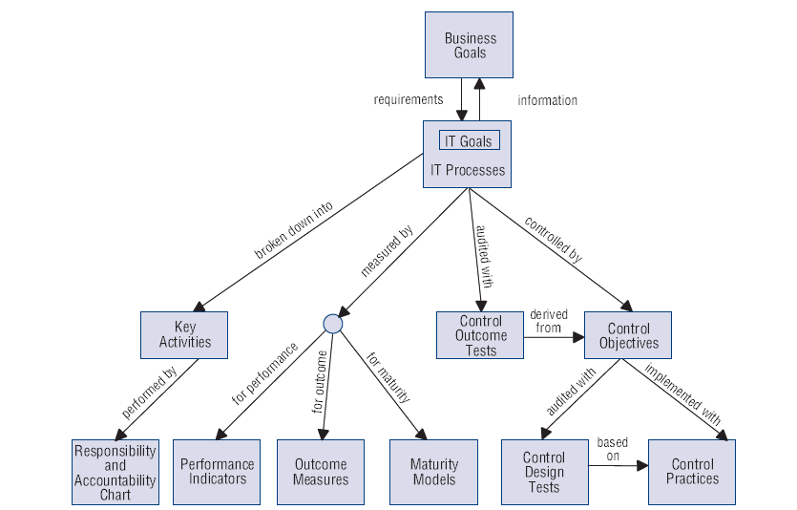
Interrelationship of the COBIT Components
Notes:
This shows all the components of COBIT and how they relate to each other.
Walk everyone through the diagram.

Slide 80
Reading
Brotby 12

Slide 81


Questions?
Matt Hale, PhD
University of Nebraska at Omaha
Interdisciplinary Informatics mlhale@unomaha.edu
Twitter: @mlhale_
Some material © 2013 Jones and Bartlett Learning, LLC
All else © 2014-2016 Matthew L. Hale

